Slide 1
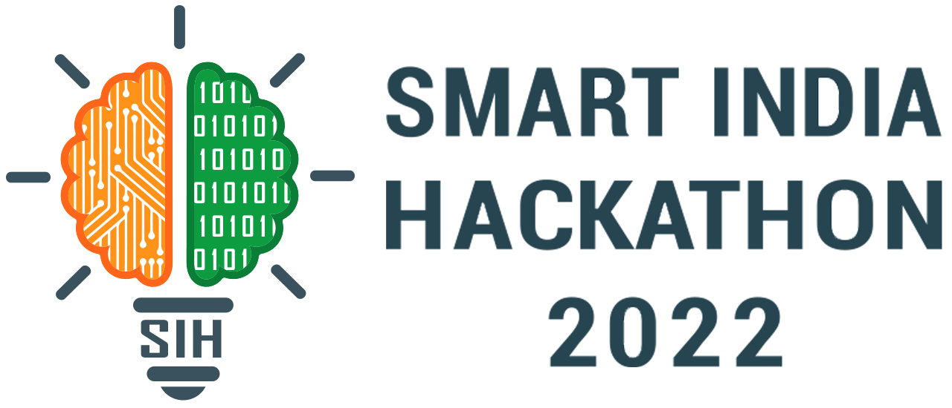
Basic Details of the Team and Problem Statement
Ministry/Organization Name/Student Innovation: AICTE, MIC-Student Innovation
PS Code:SM946
Problem Statement Title:
Team Name: Dark.Coders
Team Leader Name: Jatin Dua
Institute Code (AISHE): [C-32842]
Institute Name : Dr Akhilesh Das Gupta Institute of Technology and Management, Delhi
Theme Name:

Slide 2
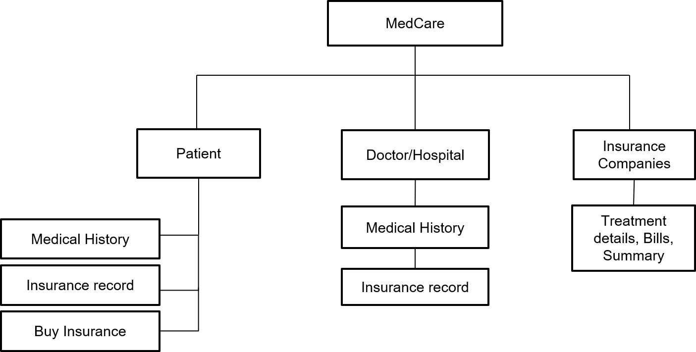
Idea/Approach Details
Process Flow chart
Describe your idea/Solution/Prototype here:
The complexity of health insurance industry has been much talked and less understood with the advent of (Third Party administrator)tpa this sector has assumed a new direction.
To overcome this problem we are coming up with solution called
This app will help patients to make claim process easy by working as a bridge between insurance companies & hospitals.
This blockchain integrated medical technology provides the patient's health records on a regularly updated basis so the insurance company can able to release insurance claims fastly, just by decentralized database.
With help of a decentralized database, patient health history, maintenance in well designed, understandable format so that doctors can able to improve their judgement, analyze ,medicate patients fastly, anywhere in the world and patient have their control over data.
Describe your Technology stack here:
Front-End: HTML,CSS,BOOTSTRAP
Back-End: Blockchain, MongoDb, NodeJS, ExpressJS
Languages: Solidity, JavaScript, Python, JSON

Slide 3
Idea/Approach Details
Describe your Use Cases here
Describe your Dependencies / Show stopper here
Fraud Prevention
With blockchain insurance claims, insurers can eliminate such common types of insurance fraud and patients personal data is secured.
Control Over the Data
Anyone willing to access the health records would require the patient’s public key. Patients could seamlessly control who should access what data.
Claim process become easy
A single ledger shared among the healthcare stakeholders. This will help in timely treatment of patients also provide accurate payment to provider.
Cashless claim facility
With the help of decentralized database
Making Electronic Health Records More Accessible with Blockchain
Electronic health records (EHR) can be hard to manage. One healthcare provider’s EHR for a patient may differ from the same patient’s other provider.
Simplified Approach to Data
Unlike a traditional way of managing information, healthcare records can be shared across multiple nodes using the healthcare blockchain.
System Interoperability
The inability to exchange healthcare records could lead to delays in treatment. But blockchain could alleviate this problem by decentralizing the data.
Efficiency
Blockchain in healthcare could turn the system highly efficient via real-time processing.

Slide 4
Team Member Details
Team Leader Name: Jatin Dua
Btech CSE IIIrd year jatindua2001@gmail.com
Team Member 1 Name: Rohit Saxena
Btech CSE IIIrd year rohit.saxena9892@gmail.com
Team Member 2 Name: Aayushi Dhama
Btech CSE IIIrd year aayushidhama494@gmail.com
Team Member 3 Name: Muskan Gupta
Btech CSE IIIrd year muskangupta61814@gmail.com
Team Member 4 Name: Ashish Sharma
Btech IT IIIrd Year sharma07101998@gmail.com
Team Member 5 Name: Hemant Singh
Btech IT IIIrd Year hemant1811singh@gmail.com
Team Mentor 1 Name: Dr. Prashant Vats
Academic Web Technology Domain Experience (in years):
Team Mentor 2 Name: Type Your Name Here
Category (Academic/Industry): Expertise (AI/ML/Blockchain etc): Domain Experience (in years):

